Slide 1

Introduction to the Qualitative
E-Research Framework
Janet Salmons, PhD

Slide 2
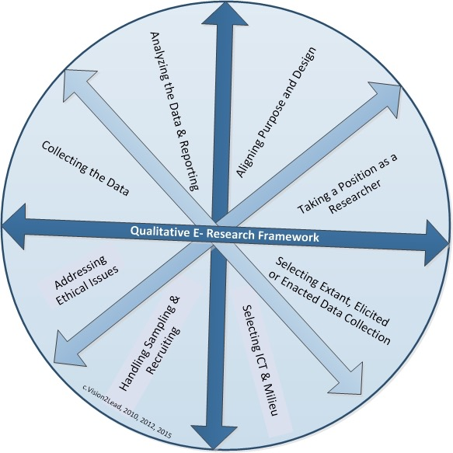
Using the Qualitative
E-Research Framework to think about design
Holistic design means considering relationships

